Slide 1
Orange Services IT Bootcamp
AI Workshop
Intro in Artificial Intelligence & ML
Andrei Gabriel Popescu ~ Data Scientist
Elena Berghila ~ Data Engineer
Raluca Priminescu ~ Data Engineer

Slide 2
Content
Short recap
- Intro to Anomaly detection
- Q/A
- Homework check

Slide 3
AI Course structure
Clustering
Classification
Regression
Intro to NN (neural networks) w/ PyTorch
- The optional assignment is on!!
Generative models
Anomaly detection - use case
- The optional assignment presentation!
For questions you can contact me:
- Andrei.popescu@orange.com

Slide 4
Intro to Anomaly Detection
Often applied to unlabeled data by data scientists in a process called unsupervised anomaly detection, any type of anomaly detection rests upon two basic assumptions:
Anomaly detection, also called outlier detection, is the identification of unexpected events, observations, or items that differ significantly from the norm.
Anomalies in data occur only very rarely
The features of data anomalies are significantly different from those of normal instances
Notes:
Outlier detection can be challenging because anomalies are often rare, and the characteristics of normal behavior can be complex and dynamic. From a business perspective, identifying actual anomalies rather than false positives or data noise is essential.

Slide 5
Anomaly detection
Anomaly detection is the identification of rare events, items, or observations which are suspicious because they differ significantly from standard behaviors or patterns.
Anomalies in data are also called standard deviations, outliers, noise, novelties, and exceptions.
Anomaly types examples:
Energy consumption for a household
Network traffic for a server
Telecom data consumption during Roaming

Slide 6
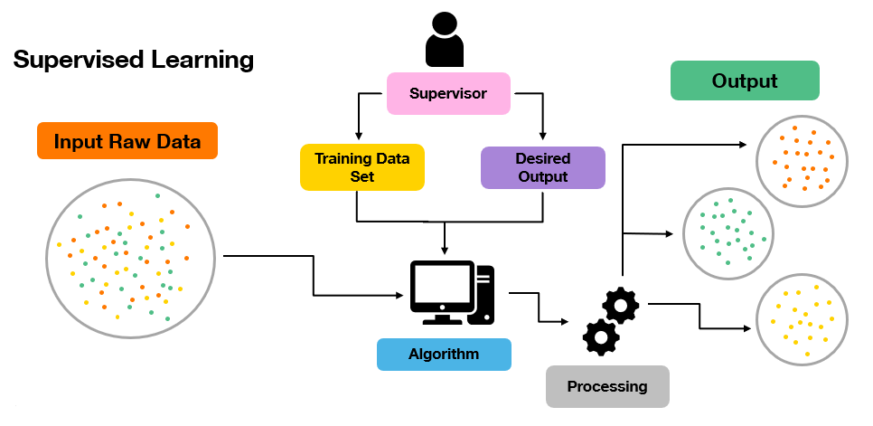
Types of learning and Anomaly Detection
Supervised learning for Anomaly Detection:
classification as „normal” and „abnormal”
rarely used because the unavailability of labelled data
unbalanced classes make classification hard
Notes:
A data set classified as „normal” and „abnormal” is required for this type of anomaly detection in order to train a classifier. This approach is not frequently used because of the need of labelled data, which is mostly unavailable, and the unbalanced classes.

Slide 7
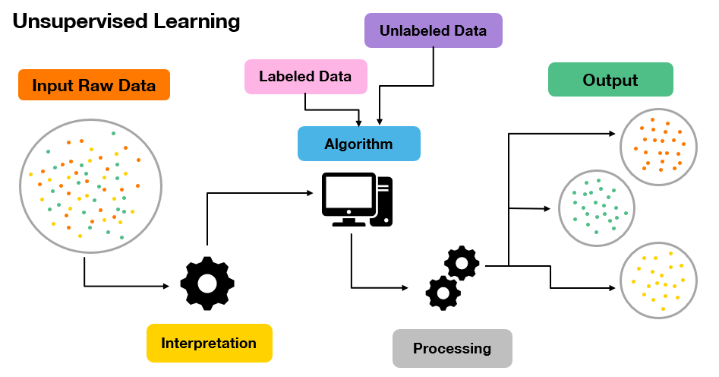
Unsupervised learning for Anomaly Detection:
the model clusters unlabeled data into a certain number of categories
points that exceed a cluster's threshold are labeled as outliers
working with unlabelled, sometimes real-time data
Notes:
A model, for example, may cluster unlabeled data into a certain number of categories depending on the relationship between data points. Points that exceed a cluster's threshold are labeled as outliers. It is sometimes hard to foresee all of the anomalies that may arise in a dataset, that’s why neural networks are invaluable when working with unlabelled, sometimes real-time, data.

Slide 8
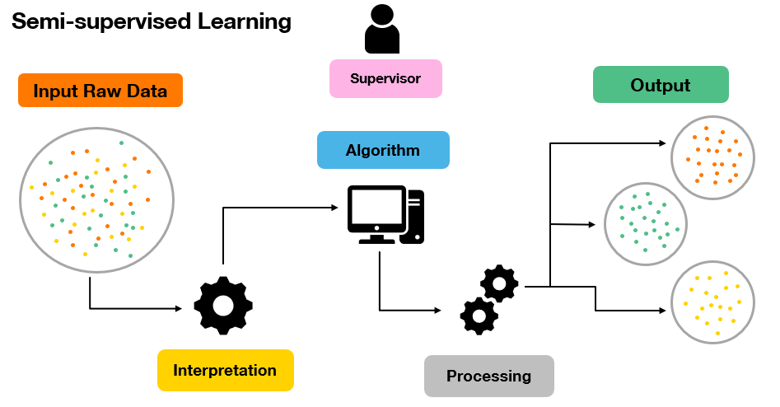
Semi-supervised learning for Anomaly Detection (with two different approaches):
builing an model reflecting normal behavior, being trained on „normal” training data, and expecting it to assess the likelihood on test data, where anomalous data also appears
building a classification algorithm based on a labelled subset of data and use that model to forecast the condition of the remaining data
Notes:
The term „semi-supervised anomaly detection” might have different interpretation: - builing an model reflecting normal behavior, being trained on „normal” training data, and expecting it to assess the likelihood on test data, where anomalous data also appears; - building a classification algorithm based on a labelled subset of data and use that model to forecast the condition of the remaining data.

Slide 9
Why is it important ?
E-commerce:
Let’s suppose we have an e-commerce platform which sells hardware components. Normal flow for sales (sales distribution) is pretty stable, around: 50 sales / day.
Because of an event (i.e Black Friday) the cost of hardware components decreased 10%. Due to this fact, the sales exploded for 8h at: 1000 sales/hour.
So, the sales time series per hour is the following:
50 / 24 -> ~2 sales / hour
T: 2 2 2 1000 … 1000 2 2 2
How can we track ?
Is this useful for company ?
Anomaly detection use cases
Fraud detection
Cybersecurity
Manufacturing and quality control
Energy, transportation and critical infrastructure
Retail and ecommerce

Slide 10
Models commonly used for anomaly detection
Isolation forest
- isolates anomalies using randomly generated decision trees
- used for detecting anomalies in high-dimensional datasets with complex structures
One-class SVM (Support Vector Machine)
- learns a decision boundary around normal data points
Autoencoders
- consist of encoder and decoder networks trained to reconstruct input data
- anomalies are identified based on the reconstruction error between input and reconstructed data
k-Nearest Neighbors (k-NN)
- used for simple anomaly detection tasks, such as outlier detection in univariate or low- dimensional datasets

Slide 11
Anomaly Detection with Autoencoders
Input Data
Autoencoder
Model
YES
Reconstruction Error
Anomaly
Error > Threshold
Output Data
Normal
Threshold
NO

Slide 12
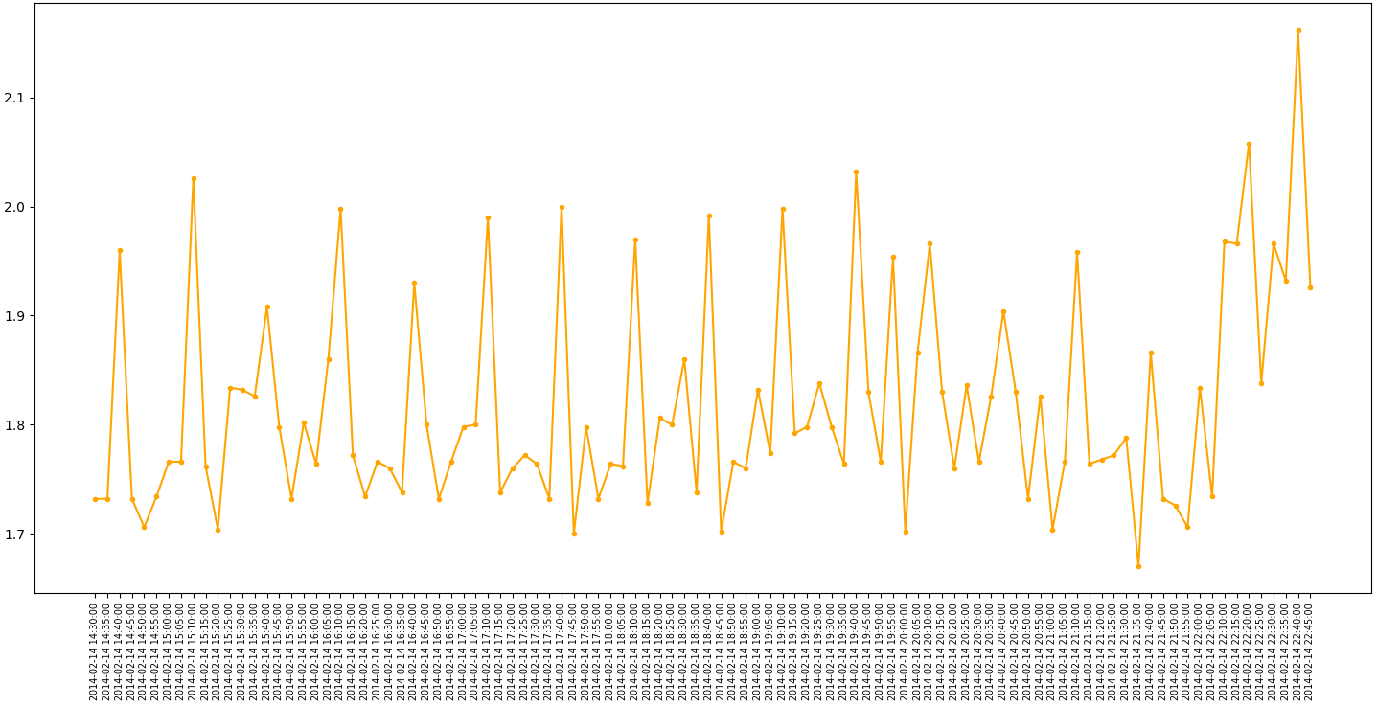

Slide 13
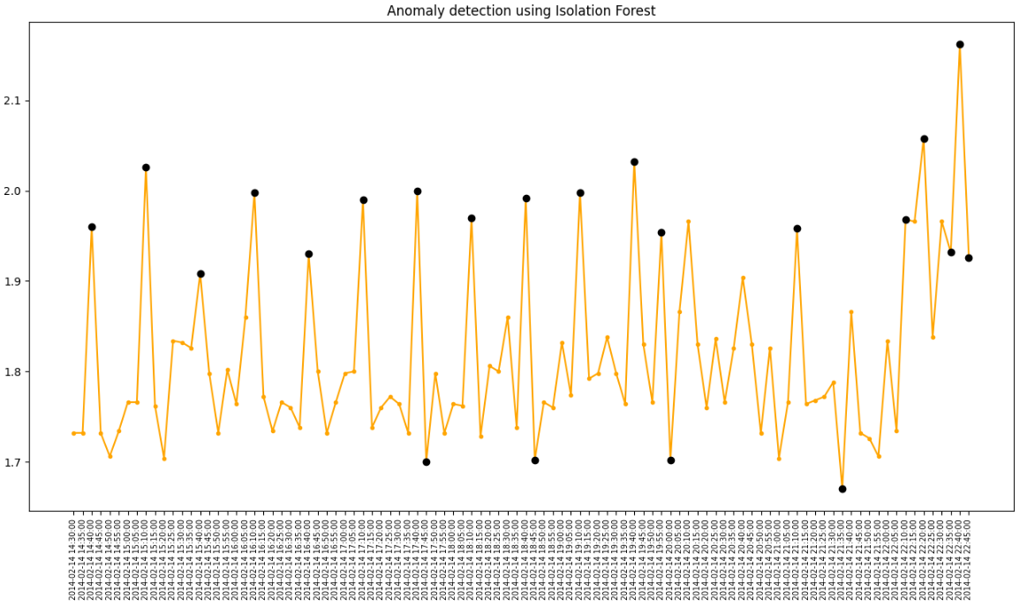

Slide 14
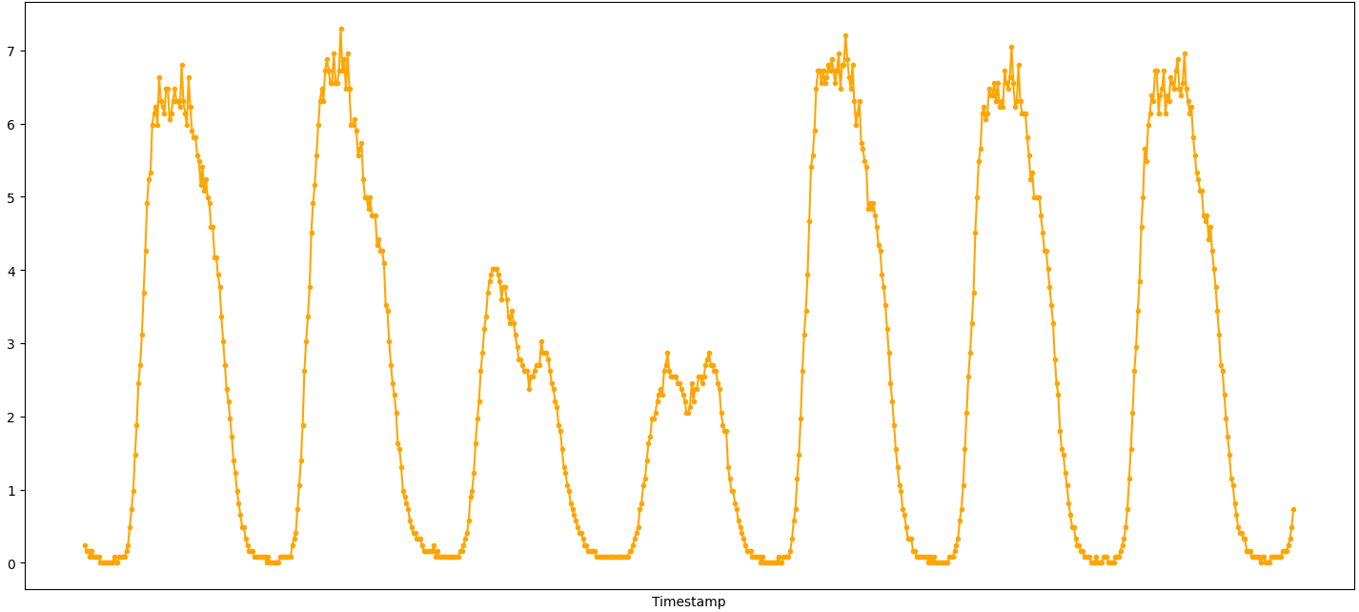
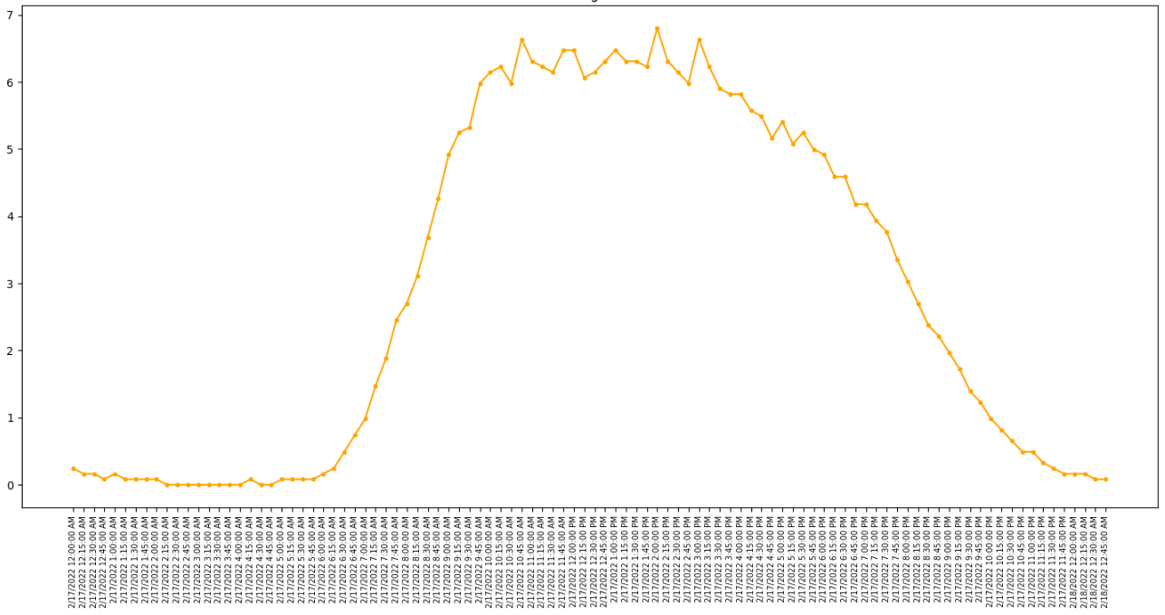

Slide 15
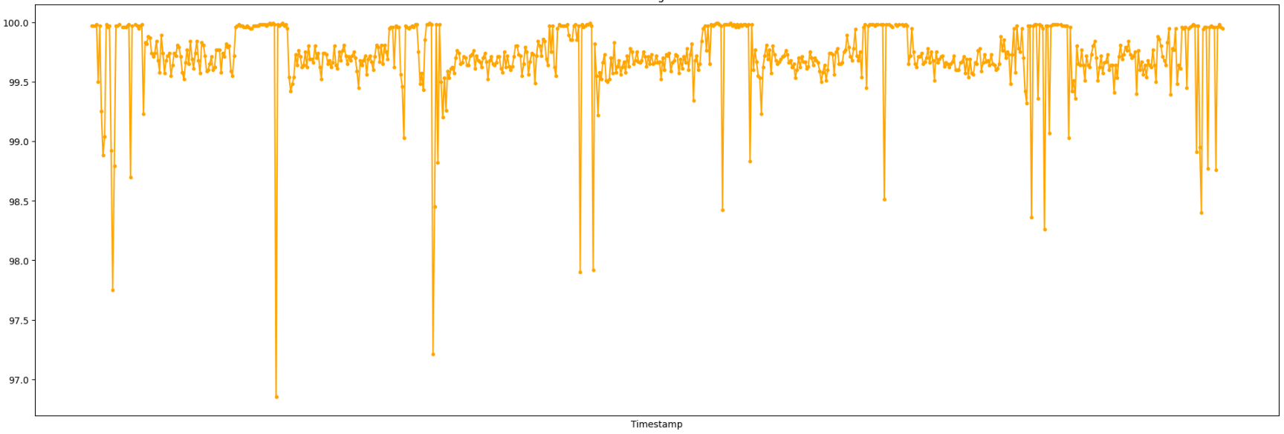
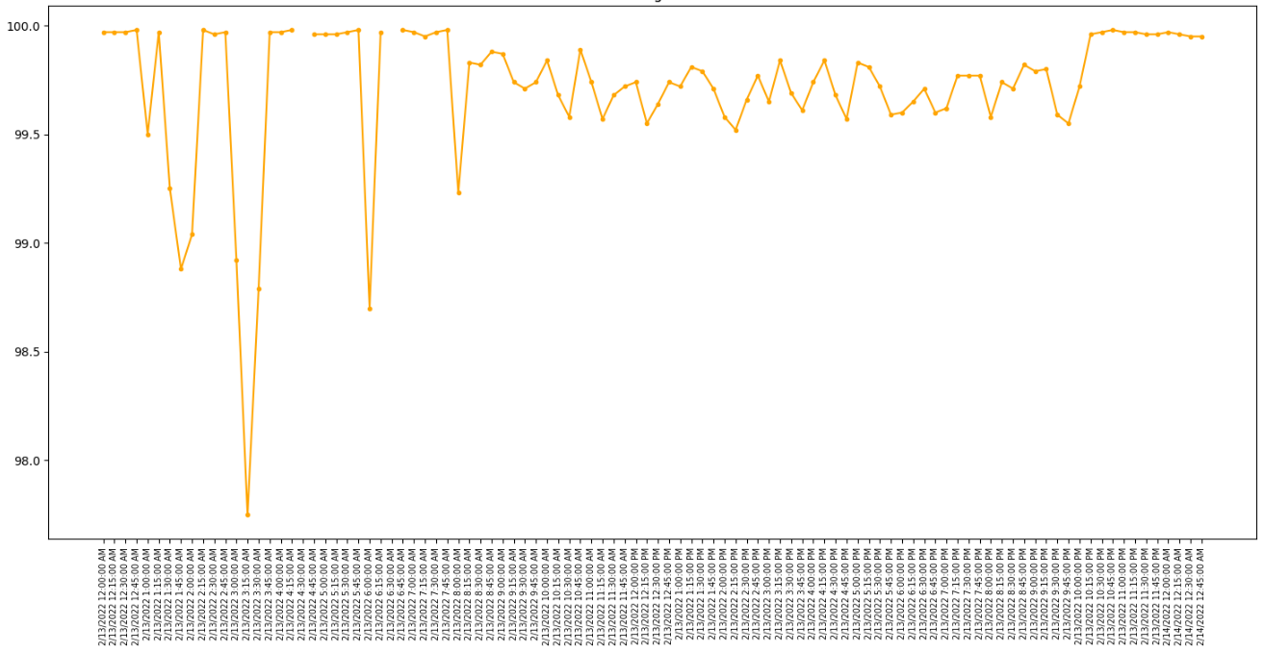

Slide 16
References
https://avinetworks.com/glossary/anomaly-detection/#:~:text=Anomaly%20detection%20is%20the%20identification,noise%2C%20novelties%2C%20and%20exceptions.
https://scikit-learn.org/stable/modules/outlier_detection.html

Slide 17
Thanks

